Slide 1
Manifold Learning and Artificial Intelligence
Lecture 4
Generative AI (2)
Denoising Diffusion Probabilistic Models
Momiao Xiong, University of Texas School of Public Health
Meeting ID: 933 1613 9423
Passcode: 416262
https://uwmadison.zoom.us/j/93316139423?pwd=Q0NVWFYvRFg5RmxCNkwxMmYrbW41dz09
momiao. xiong@gmail.com
shihcheng.guo@gmail.com
Github Address: https://ai2healthcare.github.io/

Slide 2
Denoising score matching
Son and Ermon, 2020. Generative Modeling by Estimating Gradients of the Data Distribution
Denoising Diffusion Probability Model
Ho et al. 2020; Denoising diffusion probabilistic models.
Day, 2021, An introduction to Diffusion Probabilistic Models
Bao et al. 2022; ANALYTIC-DPM: AN ANALYTIC ESTIMATE OF THE OPTIMAL REVERSE VARIANCE IN DIFFUSION PROBABILISTIC MODELS

Slide 3
1.4.3.11. Challenges of score-based generative modeling
Data are located in low dimensional manifold, not in the entire database, including high dimensional ambient space.
Since the score $∇_{x}\log{P_{data}(x)}$ may be taken in the ambient space, it is undefined when $x$ is only located in a low dimensional manifold.
Score matching algorithm provides a consistent score estimator only when the support of the data distribution is in the entire space.
We then produce samples using Langevin dynamics, which approximately works by gradually moving a random initial sample to high density regions along the (estimated) vector field of scores
Son and Ermon, 2020. Generative Modeling by Estimating Gradients of the Data Distribution

Slide 4
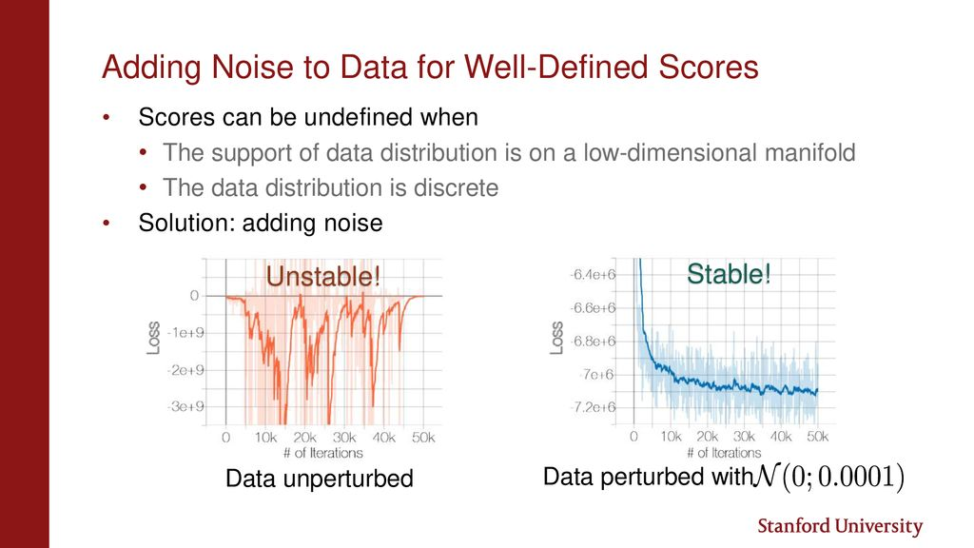

Slide 5
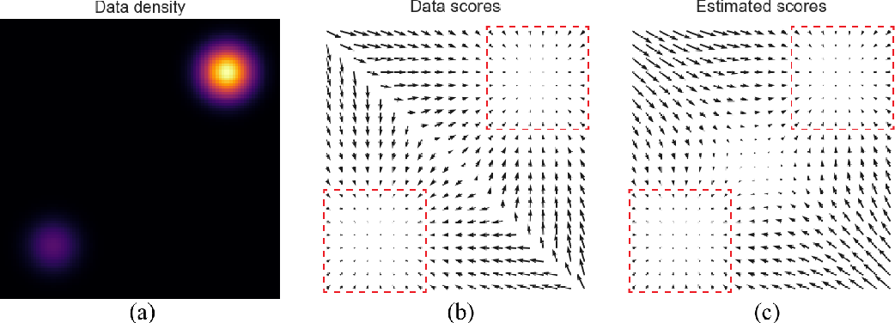
$$P_{data}\left(x\right)=\frac{1}{5}N\left(\left(−5,−5\right),I\right)+\frac{4}{5}N(\left(5,5\right),I)$$

Slide 6
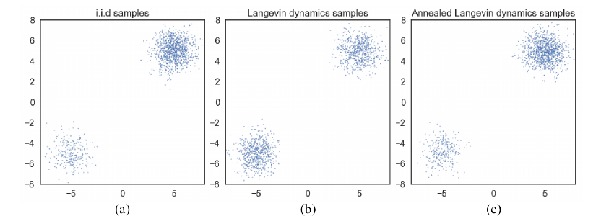

Slide 7
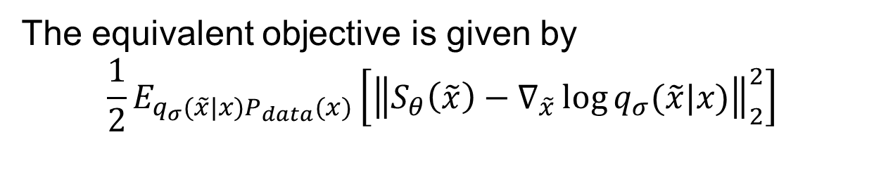
1.4.3.12. Denoising score matching
Step 1:
To avoid computing cost of $Tr\left(∇_{x}S_{m}\left(x,θ\right)\right)$, we first perturb the data $x$with a pre-specified noise distribution $q_{σ}\left(\tilde{x} | x\right).$
Step 2:
Then, employ score matching to estimate the score of the perturbed data distribution
$$q_{σ}\left(\tilde{x}\right)=\int{q_{σ}\left(\tilde{x} | x\right)P_{data}\left(x\right)dx}$$
Step 3:
The equivalent objective is given by
$$\frac{1}{2}E_{q_{σ}(\tilde{x}|x)P_{data}(x)}\left[{\left\|S_{θ}\left(\tilde{x}\right)−∇_{\tilde{x}}\log{q_{σ}(\tilde{x}|x)}\right\|}_{2}^{2}\right]$$
Note that $∇_{\tilde{x}}\log{q\left(\tilde{x}\right)=∇_{\tilde{x}}\left[\log{q_{σ}\left(\tilde{x} | x\right)+\log{P_{data}\left(x\right)}}\right]}=∇_{\tilde{x}}\log{q_{σ}\left(\tilde{x} | x\right)}$

Slide 8
Step 4:
The optimal score network minimizes the above objective functions satisfies
$$S_{θ^{∗}}\left(x\right)=∇_{x}\log{q_{σ}(x)≈∇_{x}\log{P_{data}(x)}}$$
when the noise is small such that
$$q_{σ}(x)≈P_{data}(x)$$

Slide 9
Built upon this intuition, we propose to improve score-based generative modeling by
1) perturbing the data using various levels of noise; and
2) simultaneously estimating scores corresponding to all noise levels by training a single conditional score network.

Slide 10
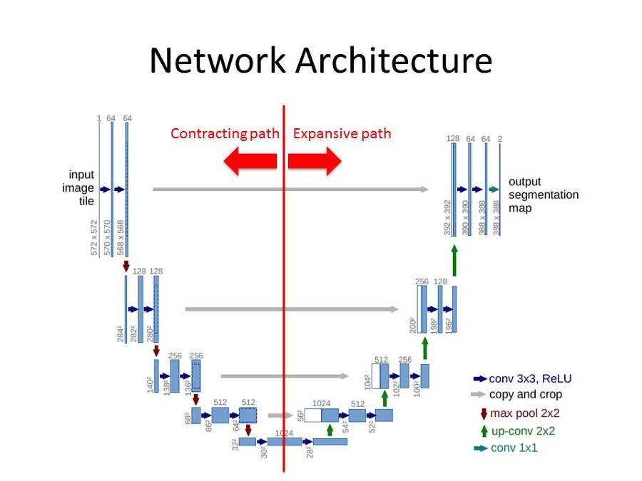
1.4.3.13. Generative Model by Score Matching
Ronneberger et al. 2015. U-Net Convolutional Networks for Biomedical Image Segmentation

Slide 11
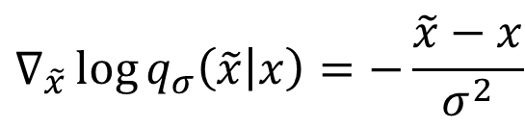

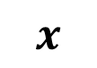
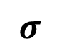

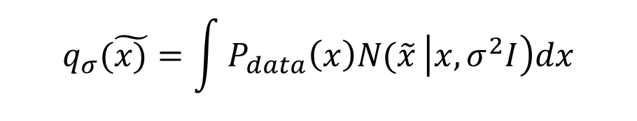

Noise Conditional Score Network $S_{θ}(x,σ)$
Define
$${\left\{σ_{i}\right\}}_{i=1}^{L}, \frac{σ_{1}}{σ_{2}}=…=\frac{σ_{L−1}}{σ_{L}}>1$$
$$σ$$
NN
$$S_{θ}(x,σ)$$
$$q_{σ}(\tilde{x)}=\int{P_{data}\left(x\right)N(\tilde{x}}\left|x, σ^{2}I\right)dx$$
$$x$$
$$∇_{\tilde{x}}\log{q_{σ}\left(\tilde{x} | x\right)=−\frac{\tilde{x}−x}{σ^{2}}}$$
Objective Function
$$l\left(θ, σ\right)=\frac{1}{2}E_{P_{data}(x)}E_{\tilde{x}\sim N(x, σ^{2})}\left[{\left\|S_{θ}\left(\tilde{x},σ\right)+\frac{\tilde{x}−x}{σ^{2}}\right\|}_{2}^{2}\right]$$
$$l\left(θ,{\left\{σ_{i}\right\}}_{i=1}^{L}\right)=\frac{1}{L}\sum_{i=1}^{L}{λ\left(σ_{i}\right)l(θ, σ_{i})}$$
$$S_{θ}\left(\tilde{x},σ\right)=∇_{\tilde{x}}\log{q_{σ}\left(x\right),λ\left(σ_{i}\right)=σ_{i}^{2}}$$

Slide 12
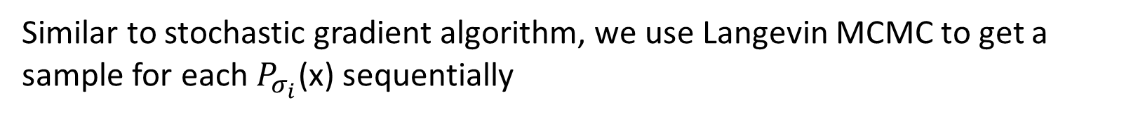
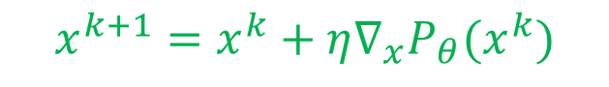

1.4.3.14. Stochastic Gradient and Langevin MCMC
(Algorithm 1)
Step 1: Solve
$$θ^{∗}=\underset{θ}{argmin}{\sum_{i=1}^{n}{σ_{i}^{2}E_{P_{data}(x)}E_{P_{σ_{i}}}\left[{\left\|S_{θ}\left(\tilde{x},σ_{i}\right)−∇_{\tilde{x}}\log{P_{σ_{i}}(\tilde{x}|x)}\right\|}_{2}^{2}\right]}}$$
Step 2:
Similar to stochastic gradient algorithm, we use Langevin MCMC to get a sample for each $P_{σ_{i}}$(x) sequentially
$$x_{i}^{m}$$
$$x_{0}=\max_{x}{P_{θ}(x)}$$
$$x_{i}^{m}=x_{i}^{m−1}+ε_{i}∇_{x}\log{P_{σ_{i}}\left(x_{i}^{m−1}\right)+\sqrt{2ε_{i}}z_{i}^{m}}$$
$$x^{k+1}=x^{k}+η∇_{x}P_{θ}(x^{k})$$
$=x_{i}^{m−1}+ε_{i}S_{θ^{∗}}\left(x_{i}^{m−1}, σ_{i}\right)+\sqrt{2ε_{i}}z_{i}^{m}, m=1,…, M, ε_{i}>0,z_{i}^{m}$ is standard normal.
Step 3: Repeat for $i=N, N−1, …, 1,$ with $x_{N}^{0}\sim N\left(x | 0, σ_{max}^{2}I\right), x_{i}^{0}=x_{i+1 }^{M}$for $i<N$
As $M→∞$ and $ε_{i}>0,$for all $i, x_{1}^{M}$ becomes an exact sample from $P_{σ_{min}}≈P_{data}\left(x\right).$

Slide 13


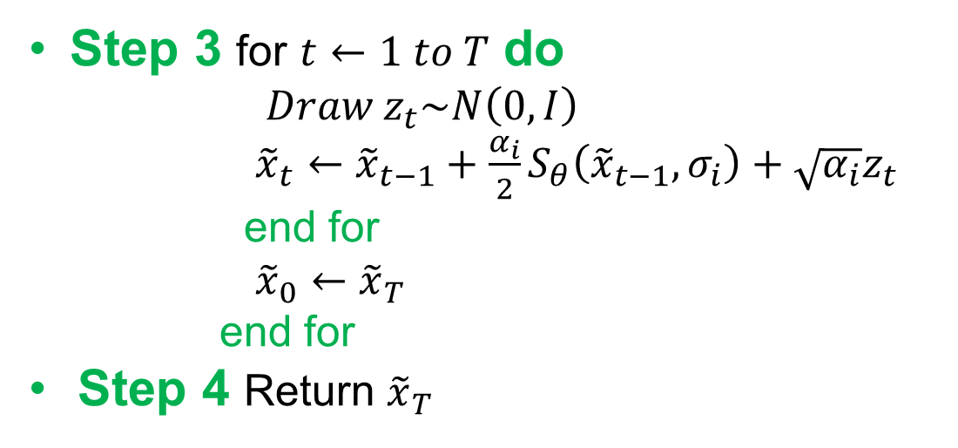
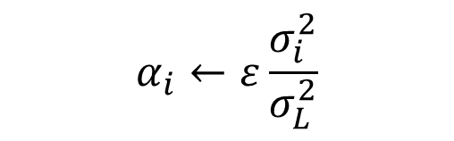

1.4.3.15. Stochastic Gradient and Langevin MCMC
(Algorithm 2)
Input ${\left\{σ_{i}\right\}}_{i=1}^{L}, ε, T$
Step 1 Initialize ${\tilde{x}}_{0}$
Step 2 For $i←1 to L$do
$$α_{i}←ε\frac{σ_{i}^{2}}{σ_{L}^{2}}$$
Step 3 for $t←1 to T$ do
$$Draw z_{t}\sim N\left(0,I\right)$$
${\tilde{x}}_{t}←{\tilde{x}}_{t−1}+\frac{α_{i}}{2}S_{θ}\left({\tilde{x}}_{t−1}, σ_{i}\right)+\sqrt{α_{i}}z_{t}$
end for
${\tilde{x}}_{0}←{\tilde{x}}_{T}$
end for
Step 4 Return ${\tilde{x}}_{T}$

Slide 14
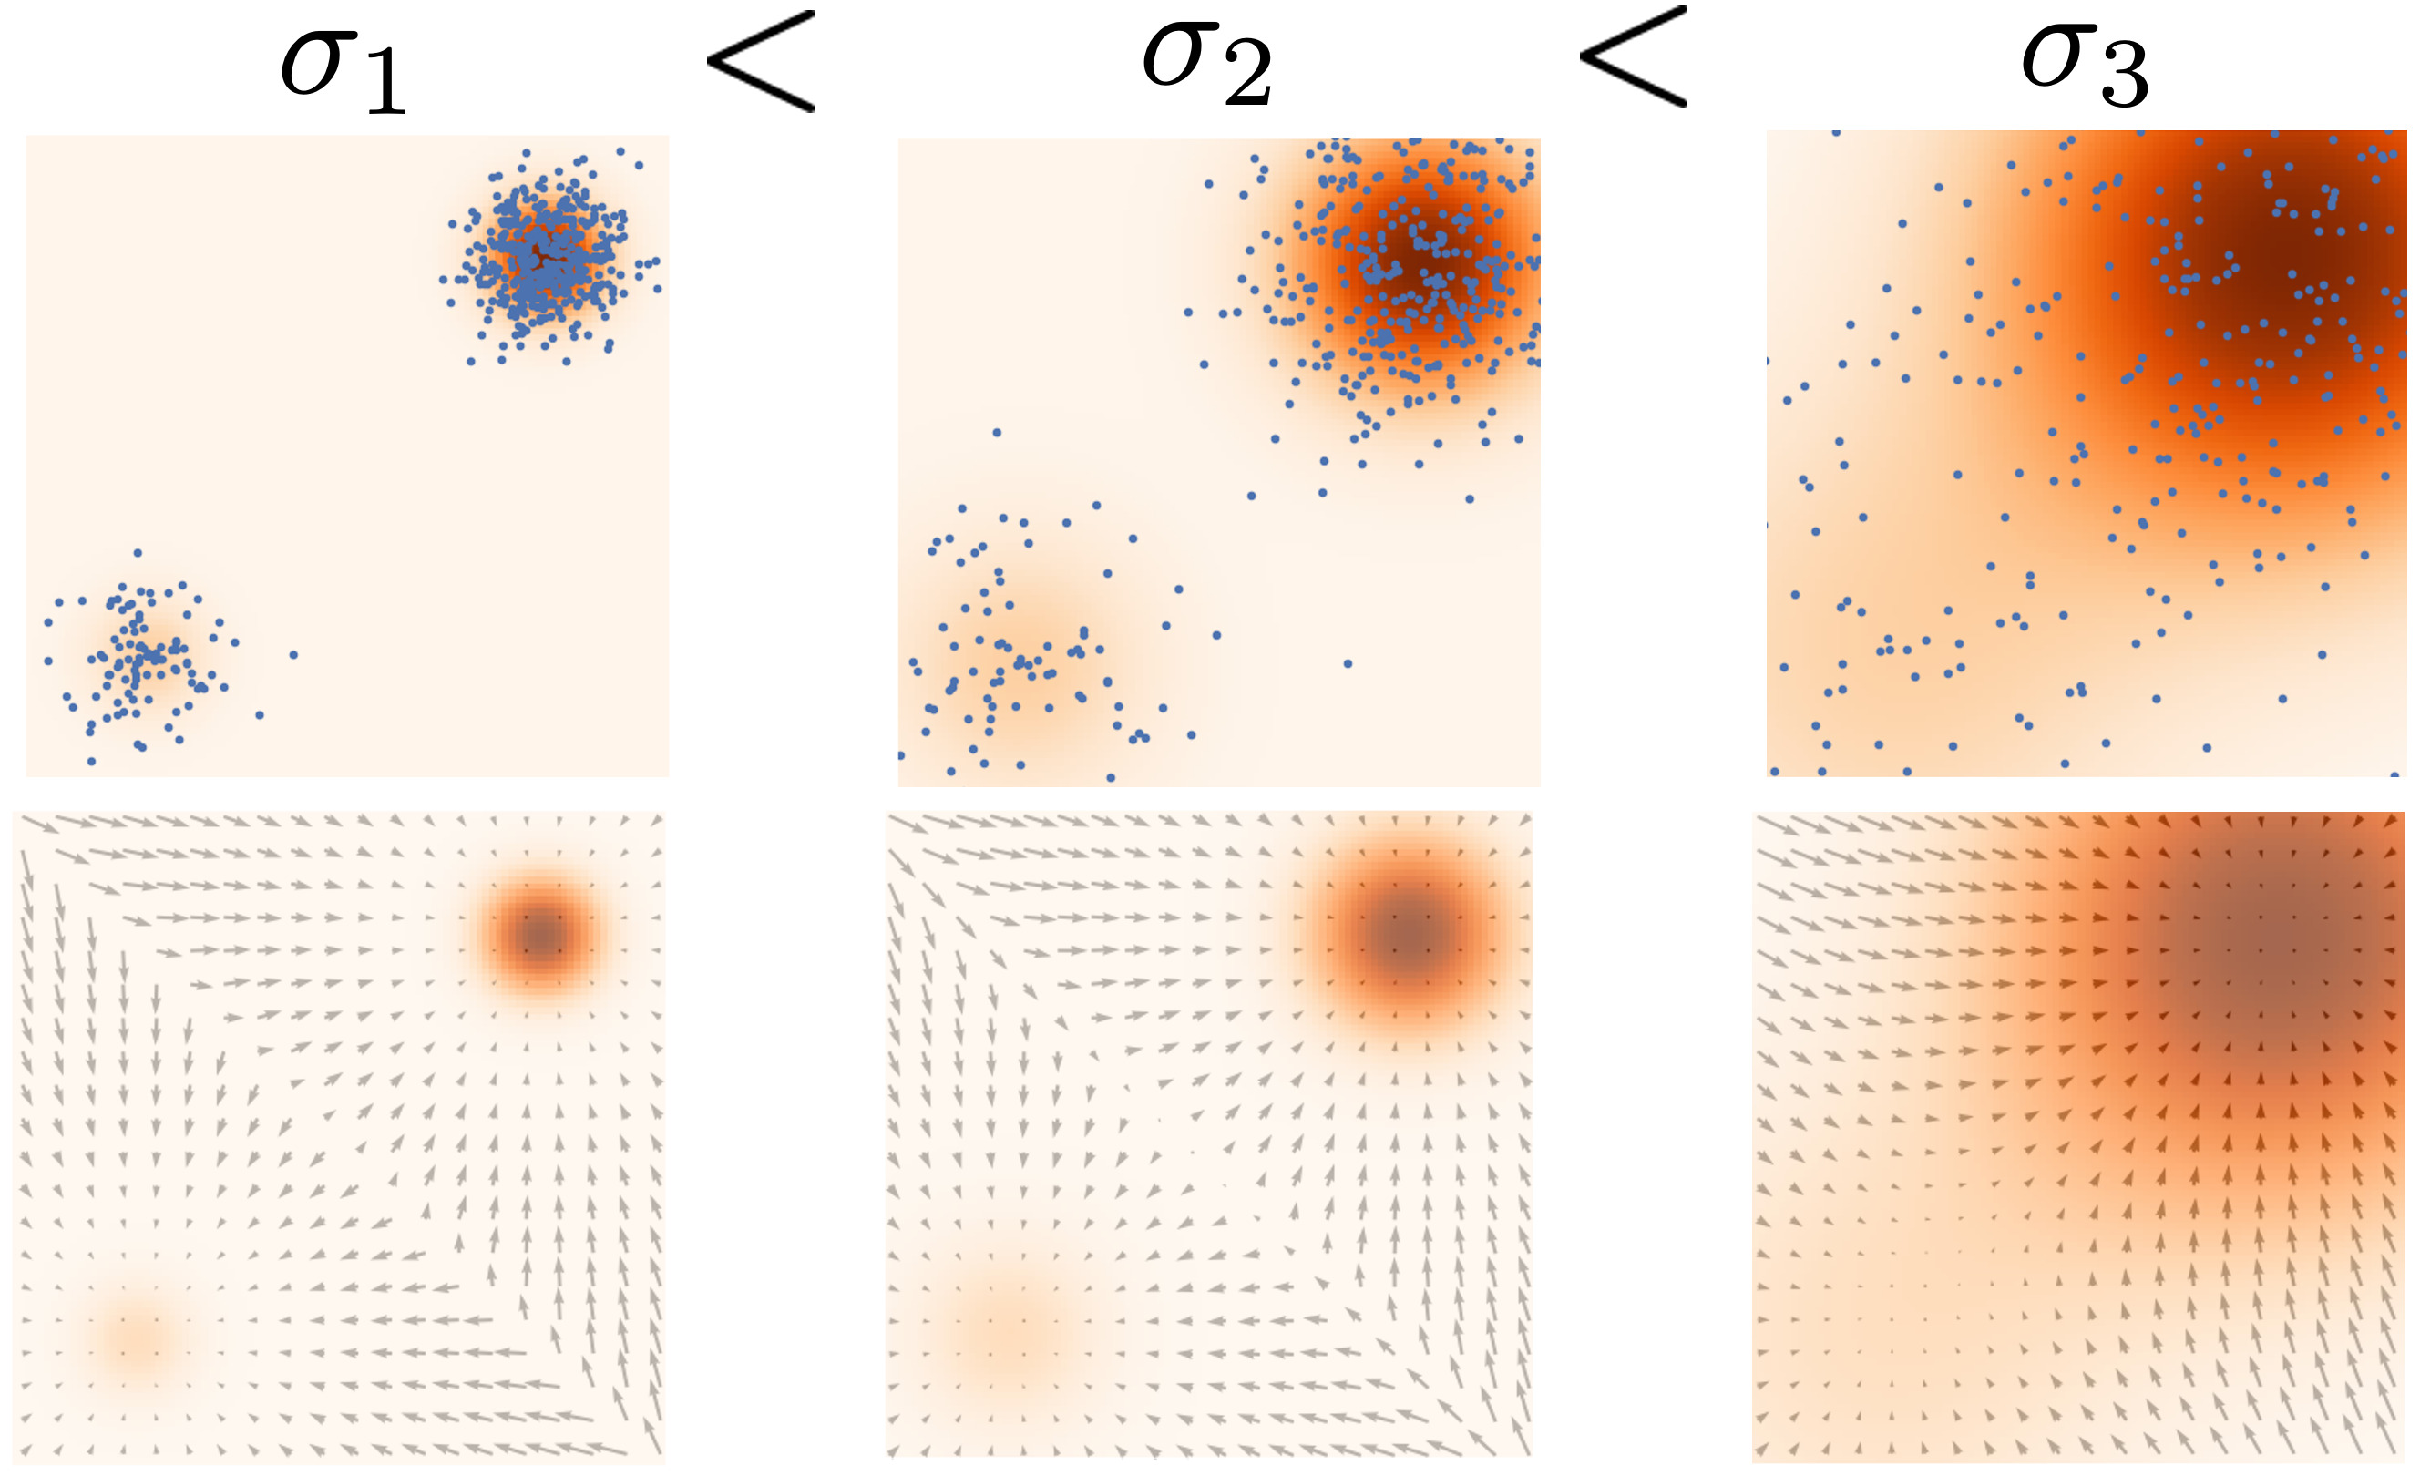

Slide 15
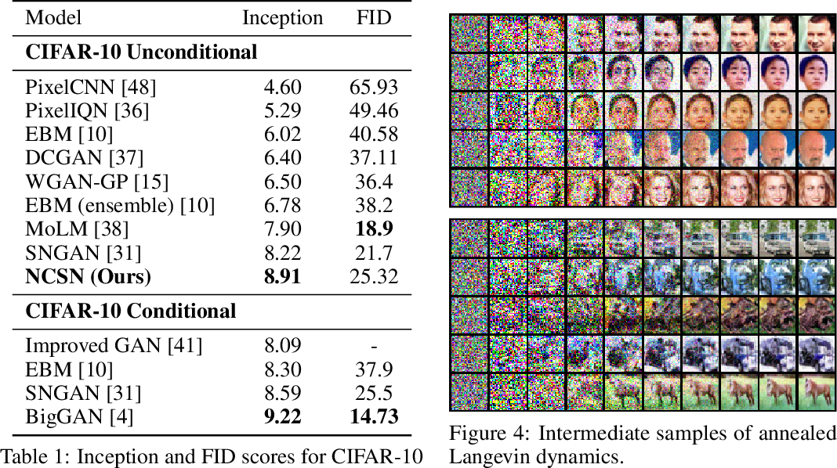

Slide 16
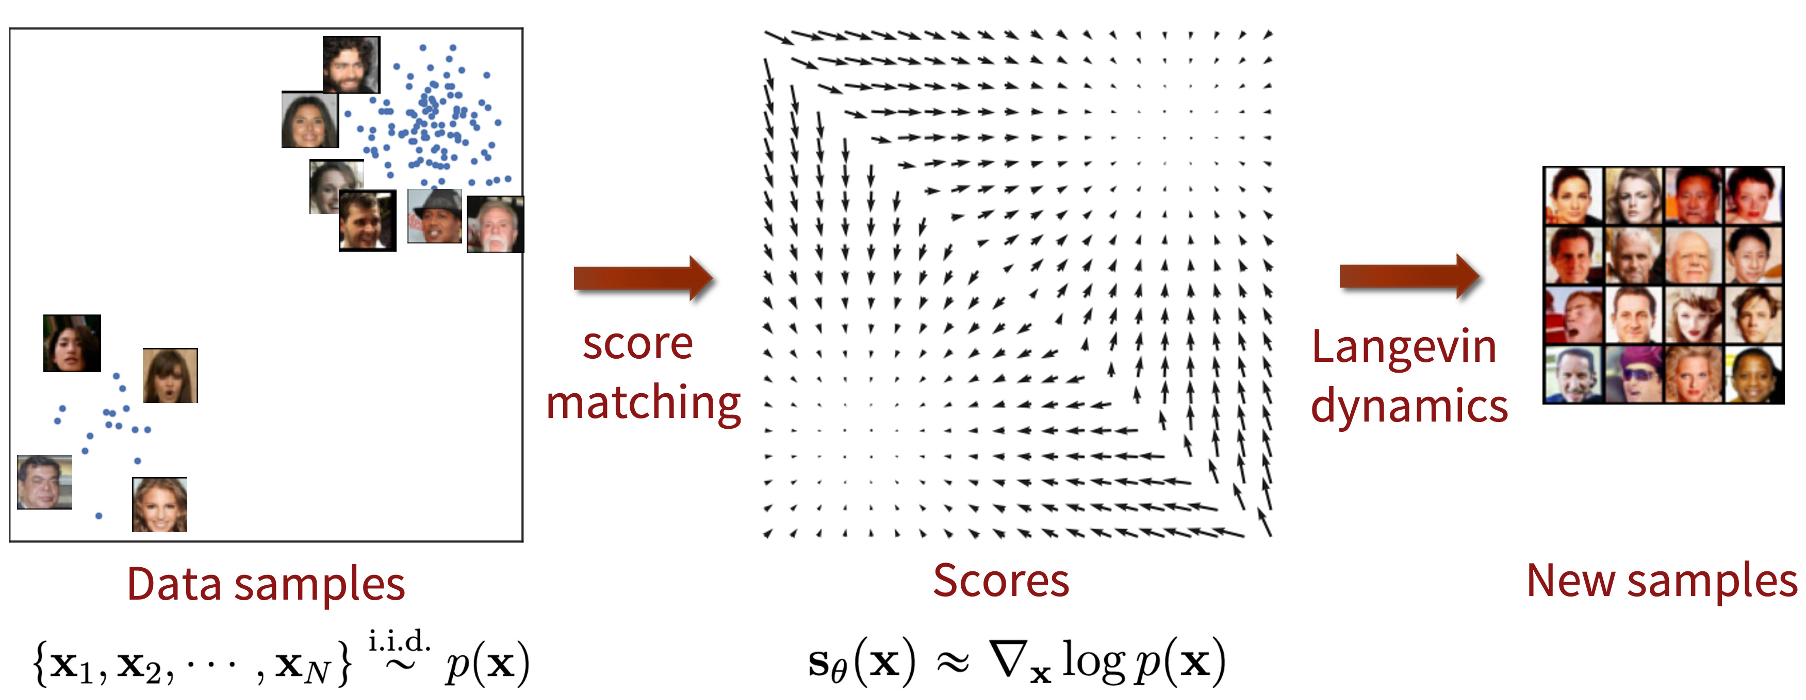

Slide 17
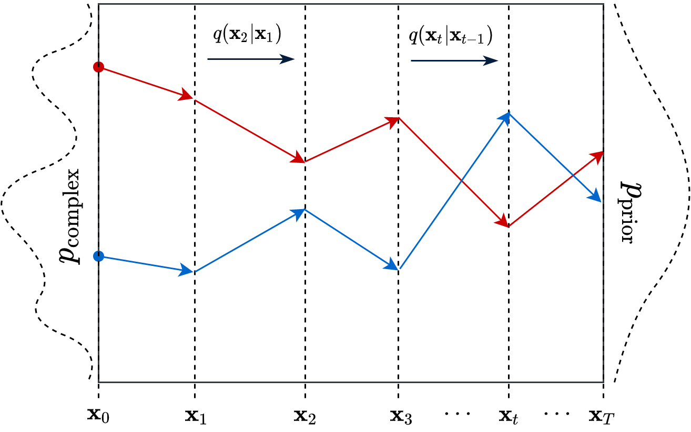
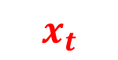
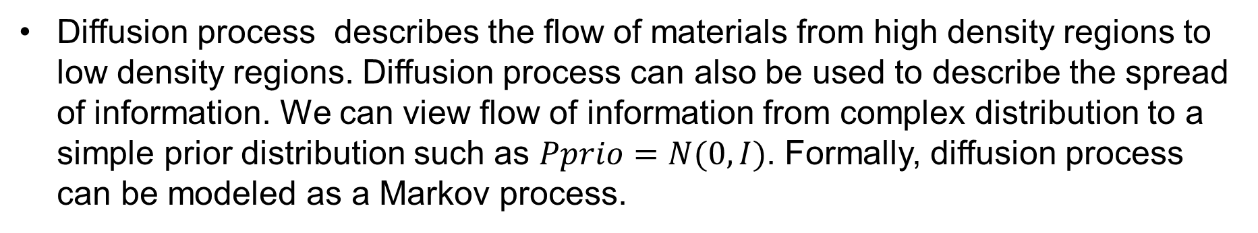
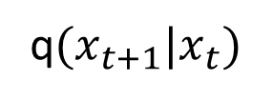
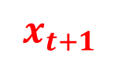
1.5. Denoise Diffusion Probability Model
Diffusion process describes the flow of materials from high density regions to low density regions. Diffusion process can also be used to describe the spread of information. We can view flow of information from complex distribution to a simple prior distribution such as $Pprio=N(0,I)$. Formally, diffusion process can be modeled as a Markov process.
$$x_{t}$$
$$x_{t+1}$$
q$(x_{t+1}|x_{t})$
Day, 2021, An introduction to Diffusion Probabilistic Models
https://ayandas.me/blog-tut/2021/12/04/diffusion-prob-models.html

Slide 18
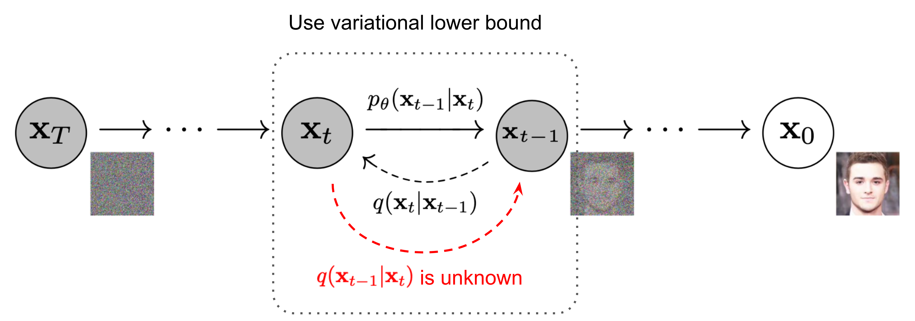
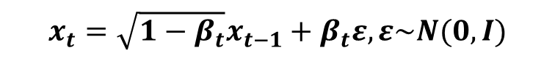
1.5.1. Forward Diffusion Process
Probability Model
$x_{0}\sim P_{data}\left(x\right)→x_{1}→x_{2}→…→x_{N}$, a Markov Process in which
small amount of Gaussian noise to the sample in $T$ steps are added.
The step sizes are controlled by a variance schedule $β_{1},…, β_{T}, β_{t}∈(0,1)$.
$$q\left(x_{t} | x_{t−1}\right)=N\left(x_{t}; \sqrt{1−β_{t}}x_{t−1}, β_{t}I\right), q\left(x_{T}\right)=P_{prior}\left(X_{T}\right)=N(X_{T},;0, I)$$
$$x_{t}=\sqrt{1−β_{t}}x_{t−1}+β_{t}ε, ε\sim N(0,I)$$
LiLiang, Weng 2021, What are Diffusion Models?
https://lilianweng.github.io/posts/2021-07-11-diffusion-models/#forward-diffusion-process

Slide 19
Recursively, we can write
$$x_{t}=\sqrt{α_{t}α_{t−1}}x_{t−2}+\sqrt{1−α_{t}α_{t−1}}{\overline{ε}}_{t−2}$$
$$=\sqrt{α_{t}α_{t−1}α_{t−2}}x_{t−3}+\sqrt{1−α_{t}α_{t−1}α_{t−2}}{\overline{ε}}_{t−3}$$
$$⋮$$
$$=\sqrt{α_{t}α_{t−1}α_{t−2}…α_{1}}x_{0}+\sqrt{1−α_{t}α_{t−1}α_{t−2}…α_{1}}{\overline{ε}}_{0}$$
$$=\sqrt{{\overline{α}}_{t}}x_{0}+\sqrt{1−{\overline{α}}_{t}}ε$$
Therefore, we obtain the transition probability
$q\left(x_{t} | x_{0}\right)=N(x_{t};$ $\sqrt{{\overline{α}}_{t}}x_{0}, \left(1−{\overline{α}}_{t}\right)I),β_{t}↑, {\overline{ α}}_{t}↓$

Slide 20
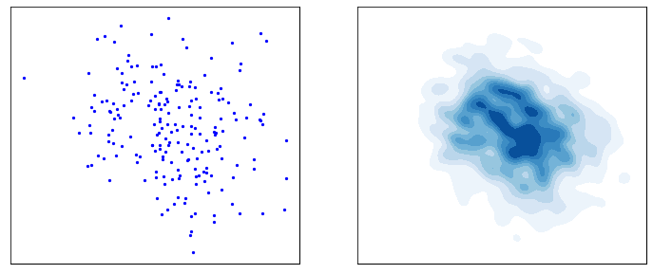
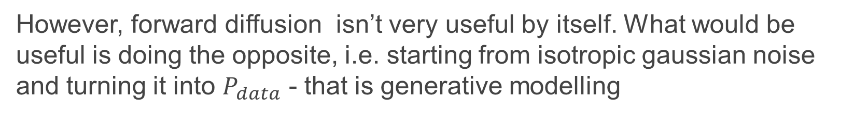
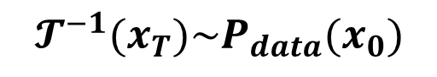
1.5.3. Reverse Diffusion
However, forward diffusion isn’t very useful by itself. What would be useful is doing the opposite, i.e. starting from isotropic gaussian noise and turning it into $P_{data}$ - that is generative modelling
$X_{T}\sim N(0,I)$
$$𝓣^{−1}(x_{T})\sim P_{data}(x_{0})$$
Day, 2021, An introduction to Diffusion Probabilistic Models

